Slide 1

BOOK SPACE
A Free Book Website

Slide 2
Project Motivation
The main motivation of the project is to help the poor by giving books for free.The primary focus will be to help the poor,but it will also be helpful to other people as well.

Slide 3
Problem Statement
In these present situations, it is difficult for poor people to even afford food,thus affording money for buying books has become a big burden for their child's education!!
Problem Solution
This website will play a major role in giving books to the poor for free which will be very helpful for them.

Slide 4
Project Overall Idea
People who want to donate their books can login to this website and can fill in the details of the book like name,genre and condition of the book. If the book is in good condition to read,then he has to give his address and then a pick up guy comes to receive it. Donors get the points or coupons which will be helpful to buy books from website with low cost ! The book will be posted on the website with title, edition, proper photo and grade of the book. Customers who are interested to buy the book can place an order with only delivery charges and order will be received as soon as possible and customers can keep track of order and can contact customer care for any further queries and updates.

Slide 5
Unique features of our website &
How this website is different from Other websites?
Unique and friendly UI / UX
There is no website with similar idea or similar UI / UX
Mypustak.com website is down and it is not selling books and not taking donation of books
Many websites resell the old books, but we are not selling the old books for money, but giving them for free of cost
Free of bugs
Give donors a gift every month who donates the most number of books
Rapid and safe with COVID preventive measures taken care while delivery
We will personally go to villages and give free books for schools and libraries

Slide 6

Functional Description
Modules : 8
Module 1: UI/UX Design
This is the first and important module in developing our website. An interactive UI/UX makes customer satisfied.

Slide 7
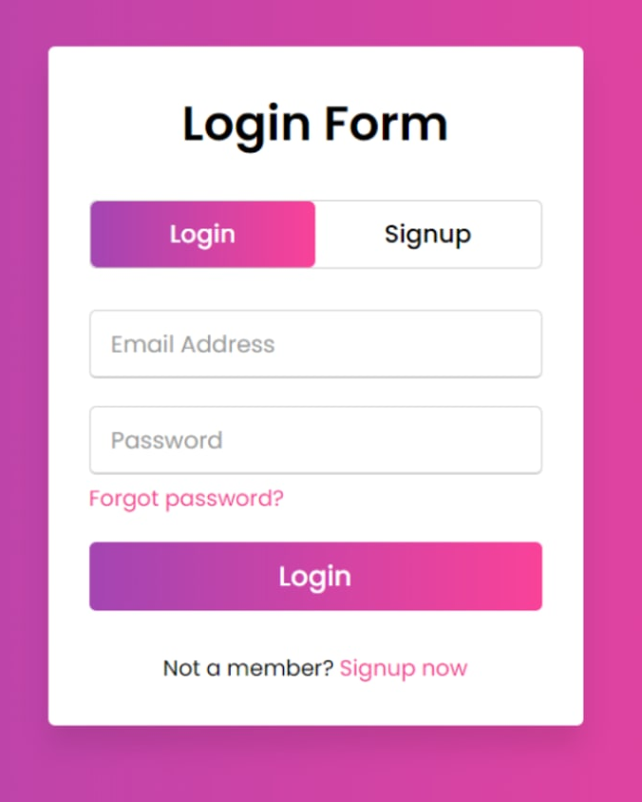

Module 2: Login/SignUp
The existing users of our website can Log In through username and password in this section. Now, If you are a new user around here, you can sign up. The user-id and password will be added to database and will be maintained securely.
Module 3: Authentication
We have to use certain API’s for connecting to the application and providing an Interface for Authentication Purpose.

Slide 8

Module 4:
Database Management
We used Django framework for maintaining the back-end of our website. By this, we will be able to connect to database and maintain user records.

Slide 9
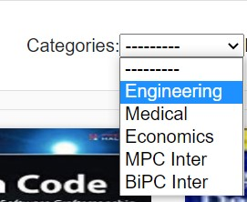
Module 5:
Product Categories and Navigation
In this module, categories are displayed using a drop down menu and the user can navigate through the category they want.

Slide 10
Module 6: User Needs:
On Choosing :
➔ “Buy books” will redirect to a page where there will be a book shelf along with a filter and a search bar.
So, the user can select the desired books and add them to the cart.
“Donate books” will redirect to a page where the donors should fill up the details like the name and address, number of books, email and phone number,upon submission it will redirect to status of submission.
➔ “Hall of Fame” will redirect to a page where top donors are listed in leaderboard with the number of books donated and can search donors by their donation ID.

Slide 11

Module 7: Shop
On this page, one can find a stack of all books and we have a filter that has category type, ISBN, and name of the book.
For each book,there is every detail of the product in this section with author,book condition and description of the book.
The products can be added to the cart then with a checkout form with shipping address and then the payment of the order.

Slide 12


Module 8 :
Deployment and Hosting
We will test our website for 2-3 weeks before deploying it for finding any bugs in the functionality of website.
We currently have hosted our website on GitHub and will deploy it on cloud based services such as Heroku.

Slide 13
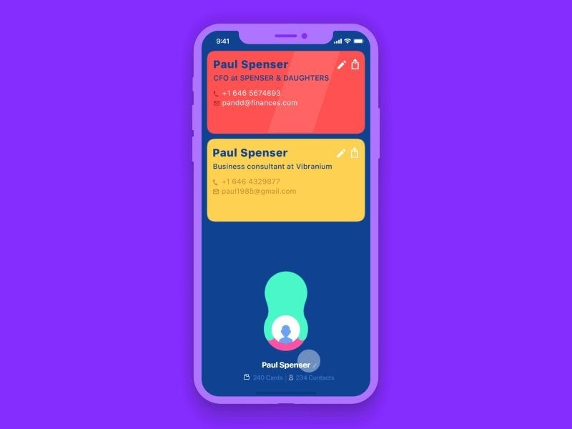

FEATURES
Better UI/UX
Easy Usage

Slide 14

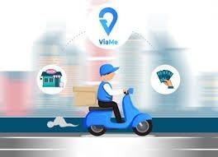
Cash on Delivery
Clean navigational menu

Slide 15

Good quality product photos with image zoom and thumbnails

Slide 16


Wish-list and Add to cart

Slide 17
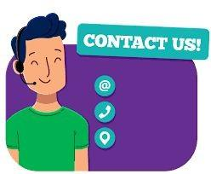
Engaging and informative “About Us” page with contact details.

Slide 18

Social media connections

Slide 19


Suggestions and user feedback is taken

Slide 20

Secure Login and User information is safe

Slide 21

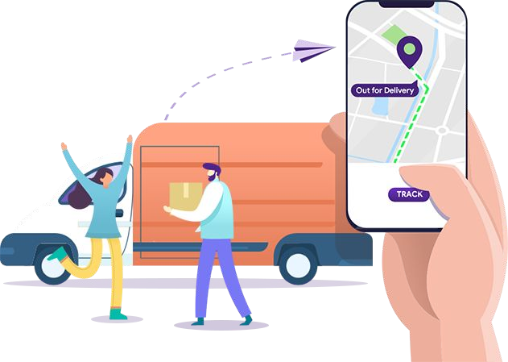
Tracking Option for Orders

Slide 22
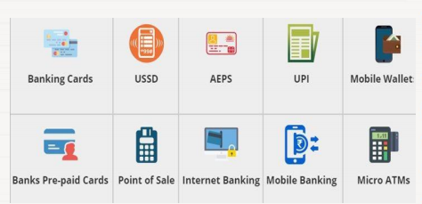
E-Payment

Slide 23


Discount offers and coupons for Donors

Slide 24

Connectivity
Hall of fame : The top 15 donors are posted in the Hall of Fame with their Name,photo and Contact information.

Slide 25

Delivery can be reached for various places across India

Slide 26


Sending Email Address
Can send a direct email for others to check about the website and can suggest a book and can interact with the Donors

Slide 27

QNA Queries
For any queries about the books and other details can ask questions and will be replied soon

Slide 28
Preliminary Work
Before Starting Project
We will draw an outline of our website
We will search for places where people require the books most first
We will tie-up with delivery companies
We will collaborate with other websites
We will initially collect books few books and provide them as a catalog to the users

Slide 29
Software Components
HTML, CSS, JS, Python, Django, Bootstrap, Django Administration, Editor - VS Code
Web Browser - Google Chrome, Firefox and Safari
Graphics Editor - Adobe Photoshop
Server - Django local server
Hosting Platform : GitHub
Cloud services- Google Drive, Heroku

Slide 30

Thanks!
Do you have any questions?
bookspace30@gmail.com +91 9490342221 bookspace.com

